Slide 1
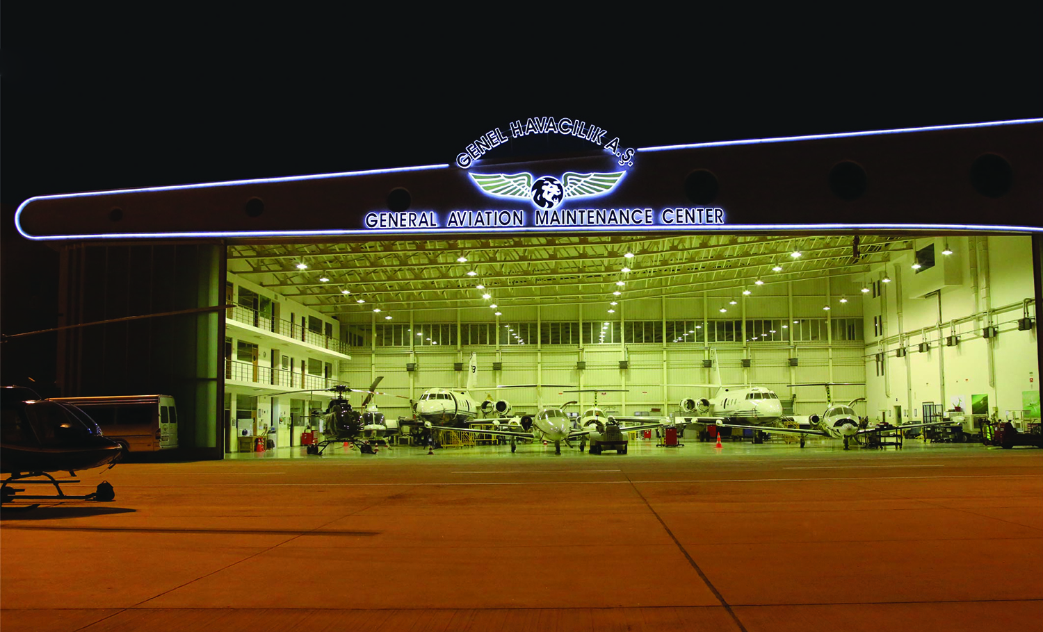
Normal Abnormal & Emergency Procedures
Training Overview

Slide 2
Introduction
Normal, Abnormal and Emergency Procedures training is of utmost importance to ensure safe operations and the ability to handle critical situations effectively.
This document covers main aspects of the curriculum for Normal, Abnormal and Emergency Procedures training given to flight crew by Genel Havacılık A.Ş.

Slide 3
Normal Operations
Pilots would receive training on standard operating procedures for various phases of flight, such as pre-flight, takeoff, climb, cruise, descent, approach, and landing.
Abnormal Operations
This section covers non-emergency abnormal situations and the procedures to address them. It includes scenarios like engine failures, system malfunctions, and non-urgent abnormal events.

Slide 4
Emergency Situations and Decision Making:
Training in recognizing and responding to critical emergency situations, focusing on quick and effective decision-making under high-stress conditions.

Slide 5
Fire and Smoke:
Procedures to detect, isolate, and combat fires in the aircraft, including the proper use of fire extinguishers and communication with ATC.
Emergency Evacuation:
Techniques for a safe and efficient evacuation of passengers and crew from the aircraft during emergency landing situations.

Slide 6
Cabin Safety and Security:
Covering procedures to handle unruly passengers, potential hijack situations, and any security threats onboard the aircraft.
Loss of Control In-Flight (LOC-I):
Specialized training to prevent and recover from situations where the aircraft loses control in-flight, which is a leading cause of accidents in aviation.

Slide 7
Hazardous Weather Operations:
Preparations for handling hazardous weather conditions, such as thunderstorms, icing, and turbulence.
Emergency Equipment and Systems:
Familiarization with the emergency equipment and systems available on the specific aircraft, including oxygen masks, emergency lighting, life rafts, and more.

Slide 8
Simulator Training:
Practical training in flight simulators, where pilots can experience various emergency scenarios in a realistic and safe environment.
Crew Resource Management (CRM):
CRM training is essential for effective teamwork and communication in the cockpit during emergencies.

Slide 9
Regulatory Compliance:
Understanding and adhering to EASA regulations related to emergency procedures training and recurrent training requirements.
Safety Management System (SMS):
Familiarizing pilots with the principles of SMS, which promotes a proactive approach to safety and encourages reporting and analyzing safety-related events.

Slide 10
Overview:
Overall, the training aims to equip flight crew with the knowledge, skills, and confidence to handle emergency situations professionally and safely, ensuring the highest level of passenger and crew safety in the event of unforeseen events.

Slide 11
Resources / Further Links
We kindly invite you to follow this link for further information on this training for specific aircraft where you can access your own related files from Remote EFB.

Slide 12
THANK YOU

