Slide 1
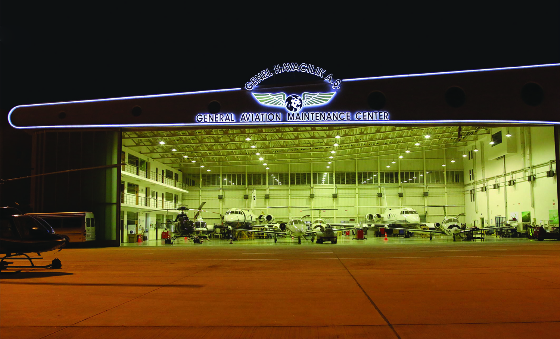
Pre/Post Flight Procedures
Training Overview

Slide 2
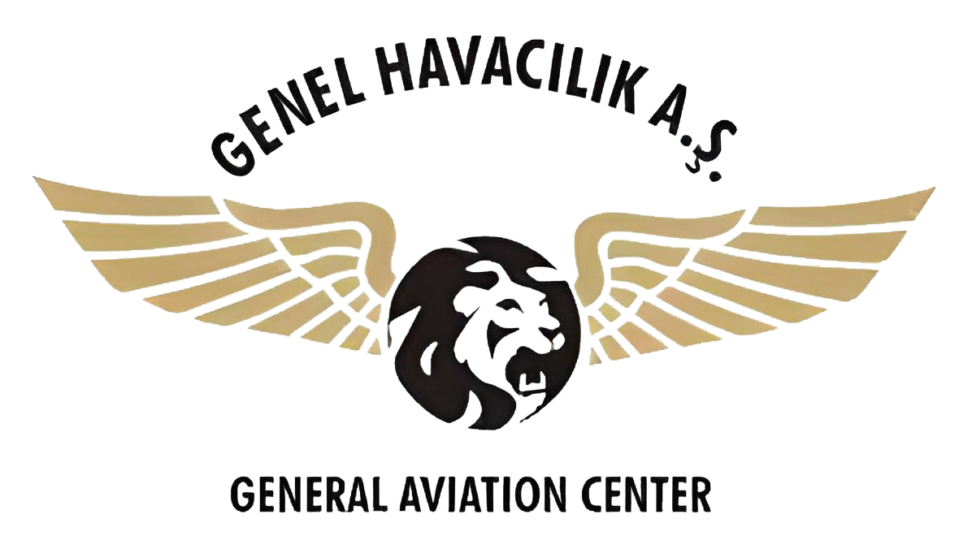
Introduction to Pre-Flight Procedures
Pre-flight procedures are performed by the flight crew and ground personnel before the aircraft takes off. These procedures aim to ensure that the aircraft is airworthy, all systems are functioning correctly, and all necessary preparations are made for a safe flight.
Following pages cover main aspects of the curriculum for Pre-Flight Procedures training provided to flight crew by Genel Havacılık A.Ş.

Slide 3
Pre-Flight Inspection
The flight crew conducts a thorough inspection of the exterior and interior of the aircraft, checking for any visible damage, debris, or signs of fluid leaks. They also inspect the flight controls, landing gear, lights, and other external components.
Weight and Balance Check:
The weight and balance of the aircraft are calculated to ensure that it is within its safe operating limits and properly balanced for the intended flight.

Slide 4
Flight Planning:
The flight crew reviews the flight plan, weather conditions, and any potential hazards along the route. They calculate fuel requirements and consider alternate airports in case of diversions.
Cockpit Setup:
The flight deck is prepared for the upcoming flight, including setting up navigation systems, communication equipment, and ensuring all required documents and charts are available.

Slide 5
Briefings:
The crew conducts pre-flight briefings, discussing the flight plan, roles and responsibilities during the flight, emergency procedures, and any other relevant information.
Passenger Briefing:
For commercial flights, the cabin crew briefs passengers on important safety information, including seatbelt usage, emergency exits, and the use of safety equipment.
Clearance and ATC Communication:
The flight crew obtains clearance from Air Traffic Control (ATC) and communicates any special requests or considerations.

Slide 6
Introduction to Post-Flight Procedures
Post-flight procedures are performed after the aircraft has completed its flight and arrived at its destination. These procedures are important for assessing the condition of the aircraft after the flight and ensuring it is ready for the next operation.
Following pages cover main aspects of the curriculum for Post-Flight Procedures training provided to flight crew by Genel Havacılık A.Ş.

Slide 7
Parking and Shutdown:
The aircraft is parked at the designated location, and the engines and systems are shut down.
Secure the Aircraft:
Doors and hatches are closed and secured, and appropriate steps are taken to prevent unauthorized access to the aircraft.

Slide 8
Post-flight Inspection:
The flight crew and ground personnel conduct a post-flight inspection to check for any new issues or discrepancies that may have arisen during the flight.
Documentation:
The technical log is updated with flight details, fuel consumption, any defects noted during the flight, and any maintenance actions taken.

Slide 9
Debriefing:
After the flight, the flight crew may conduct a debriefing session to discuss the flight's performance, any challenges encountered, and any lessons learned for future improvements.
Maintenance and Cleaning:
If required, the aircraft may undergo routine maintenance and cleaning procedures to ensure it is ready for the next flight.

Slide 10
Overview
Both pre-flight and post-flight procedures are critical to maintaining the safety and efficiency of flight operations. They help identify and address issues before they become safety concerns and ensure that the aircraft remains in optimal condition for continued operations.

Slide 11
Resources / Further Links
We kindly invite you to follow this link for further information on this training for specific aircraft where you can access your own related files from Remote EFB.

Slide 12
THANK YOU

